Slide 1
INTRODUCING MY HABIT TRACKING APP

Slide 2
Task 1 : Create a Habit Tracking App
Development Phase

Slide 3
TABLE OF CONTENTS
INTRODUCTION
DESIGN OVERVIEW
TOOLS AND TECHNOLOGIES
HABIT CREATION AND MANAGEMENT
HABIT INSPECTION AND ANALYSIS
CONCLUSION

Slide 4

1
ABOUT HABIT TRACKER
Introduction and key benefits

Slide 5
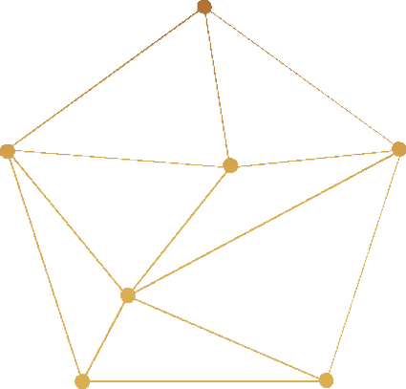
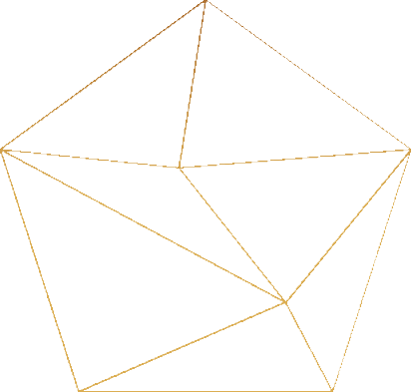






ABOUT THE HABIT TRACKER
Habit Tracking
Manage and oversee your habits efficiently.
Database Integration
Database Integration Secure and streamlined habit data storage with JSON.
User-Friendly Interface
Leverages Tkinter for seamless navigation, visually captivating, and user-friendly interface.
Habit Analysis
Users can track their progress, analyze habit history, and obtain valuable insights

Slide 6
2
DESIGN OVERVIEW
Key components and their main functionalities

Slide 7



KEY COMPONENTS
Habit
Represents individual habits and provides analytics such as completion rate and streak computation.
HabitTrackerDB
Manages all database operations, guaranteeing smooth data storage and retrieval.
HabitTrackerGUI
Serves as the graphical user interface, facilitating user-friendly interaction.

Slide 8




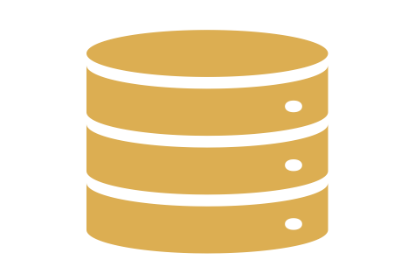
COMPONENT INTERACTIONS
Habit Monitoring and Analysis
HabitTrackerGUI
Habit
Store and retrieve data
Store and retrieve habit related information
HabitTrackerDB

Slide 9

TOOLS AND TECHNOLOGIES Frameworks and libraries
3

Slide 10
Python
Tkinter
Json
Python GUI toolkit for constructing the app's graphical user interface
The primary programming language for the Habit Tracker app
This could involve storing information such as habit
names, completion status, streaks, timestamps, and
any other relevant details
in JSON format
Chosen for its:
Selected for its:
simplicity
readability
extensive libraries
cross-platform compatibility
seamless integration with Python

Slide 11

HABIT CREATION AND MANAGEMENT Process of creating a habit
4

Slide 12
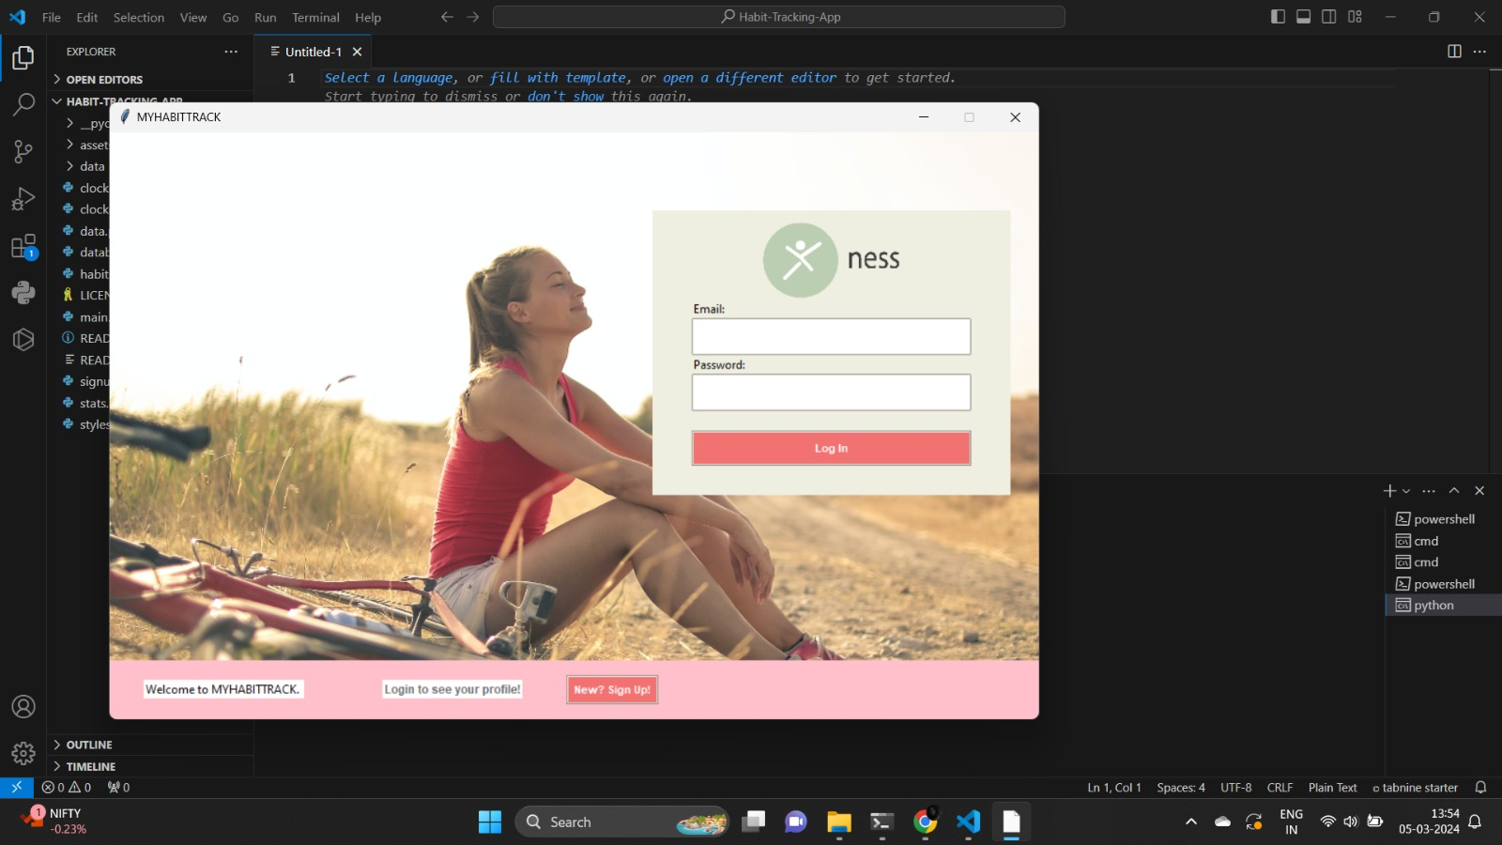
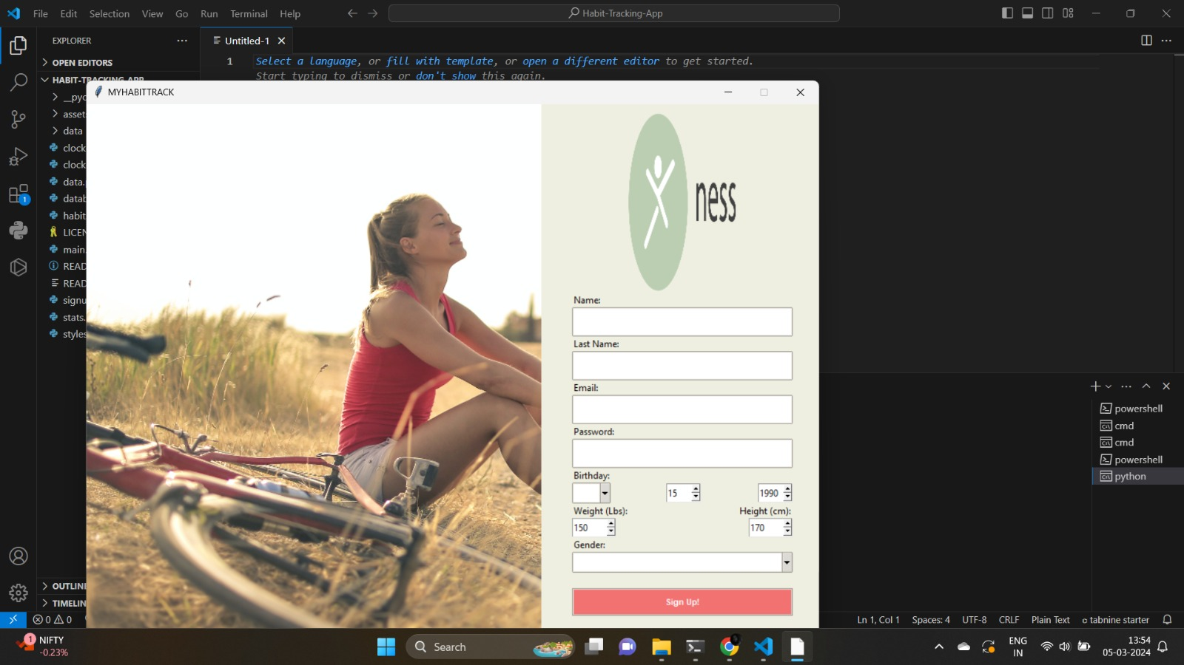
When you run the main.py file, the Habit Tracker application greets you with a login window. This window serves as the entry point to the app and provides a starting point for user login
Before Login you have to create your account by providing your credentials like name, email, password etc you can signup and then you can login

Slide 13
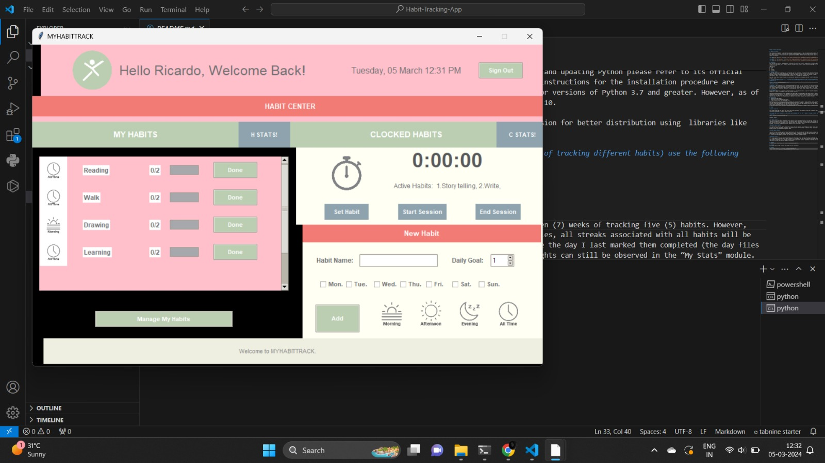
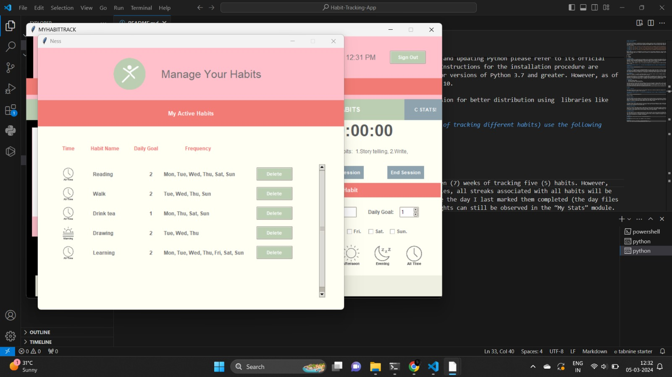
After login successfully center window will open here you can add the new habit and manage the habit and also you can check the habit status and clock status by clicking the H STATS and C STATS BUTTON
When we add the new habit the habit is stored in manage your habits panel. Here we can delete the Habit.

Slide 14

5
HABIT INSPECTION AND ANALYSIS
Process of inspecting habits and viewing statistics

Slide 15
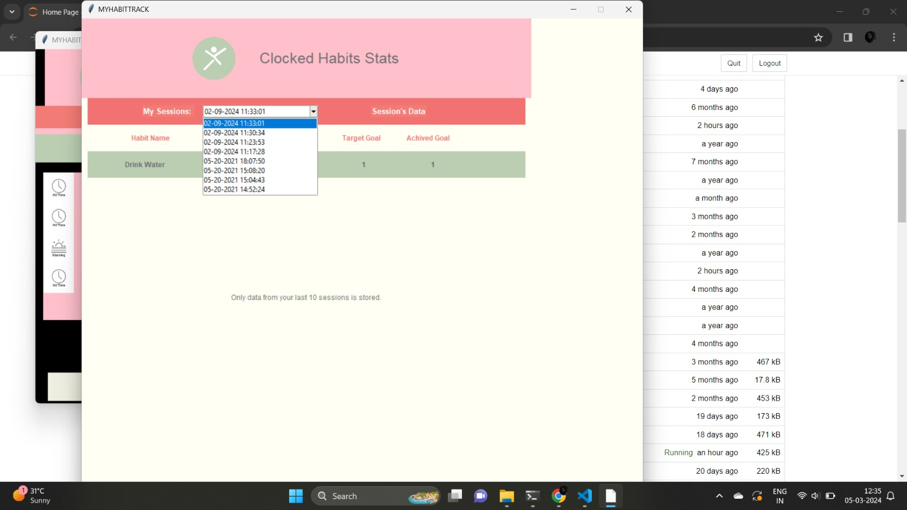
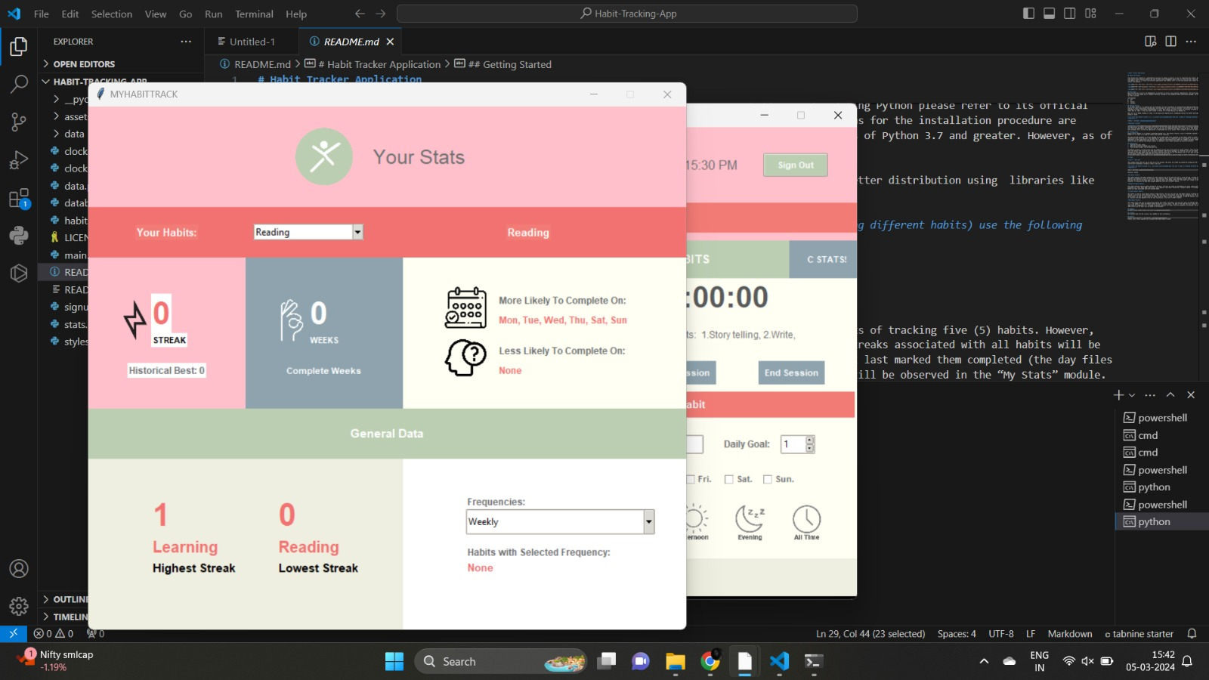
Set the clock for 1 min by clicking on the start session after completing the set session of 1 min, end the session by clicking on end session button. After end the session will check the clock status. In their it will shows the frequency, Time Elapsed taget goal, Achieved goal.
In this window we check the habit status (Highest Streak and Lowest Streak) and also completion of weeks

Slide 16
₆
CONCLUSION
Summarizing the main points

Slide 17
This project is created as a comprehensive solution for people in need of a tool for improving their habits. Ness is a habit tracking app with powerful data analysis modules and user-friendly habit management panels that will help the user track and extract valuable information from habits. Ness is a strong cross-platform application that enables users to track and analyze their habits as a mean to improving their overall life quality.

Slide 18








THANK YOU

